Slide 1
DIPLOMA PROJECT
CBR currency exchange (variant 5)
Student: Ildar Sharafeev
Cloud&DevOps Internship
Stream 24
2022

Slide 2
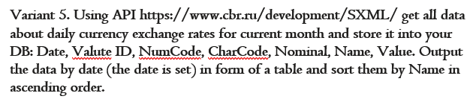
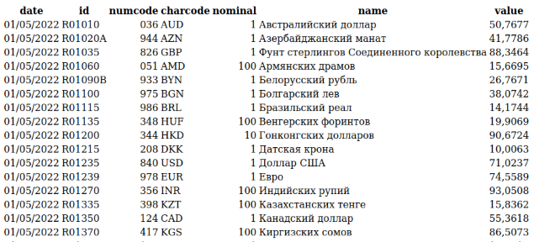
Application
https://github.com/shilfar/cbr1.git
https://github.com/shilfar/cbr.git

Slide 3










Technology stack

Slide 4
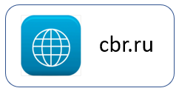

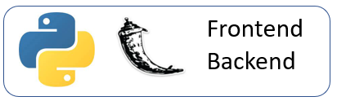

App architecture
AWS EKS
Python/Flask
AWS RDS
PostgreSQL

Slide 5
Branching strategy:
Main branch
Deploy
Production environment
Dev branch
Deploy
Development environment
V0.1
V0.2
V0.3

Slide 6


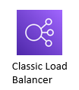











AWS Infrastructure
diagram
AWS Cloud

Slide 7




CI/CD Diagram
AWS EKS
Dev
Prod
Dev environment
Pull
Push
1
Monitoring
2
3
Push
5
Pull
Logging
Deploy
6
4
Prod environment
Build
8
Review
Monitoring
7

Slide 8
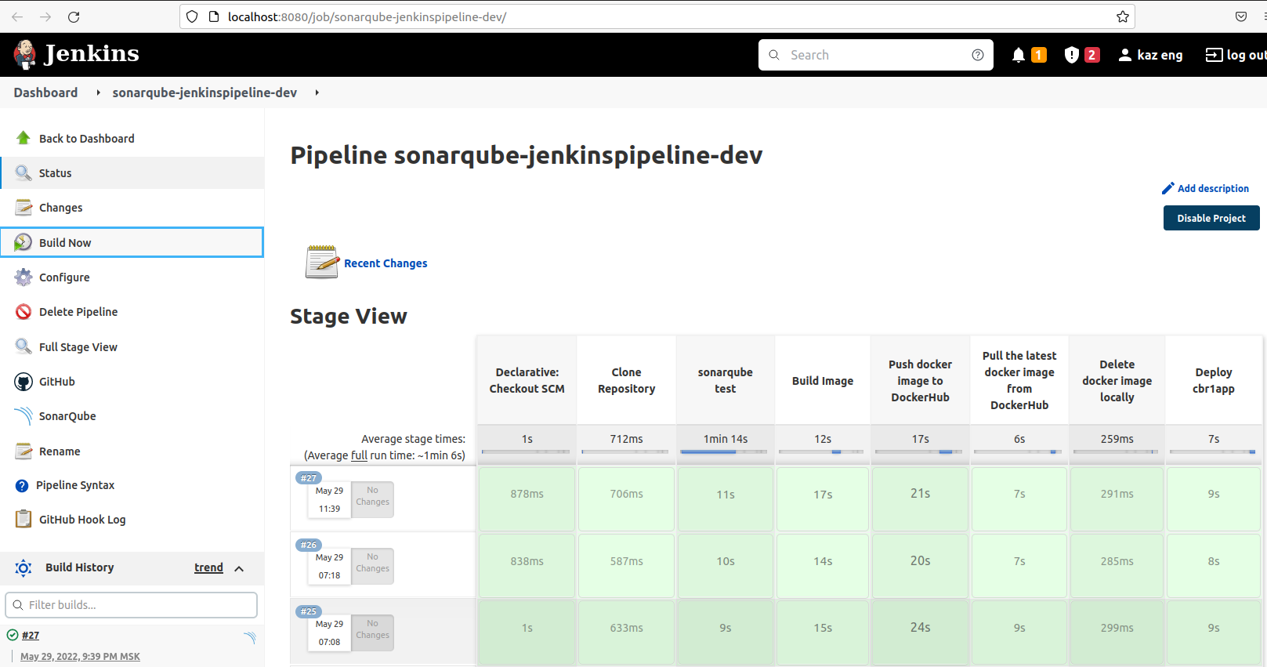
Automation server

Slide 9
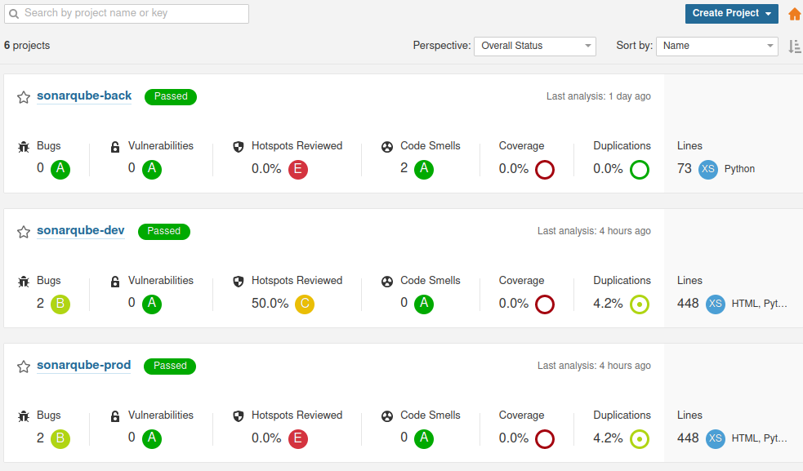
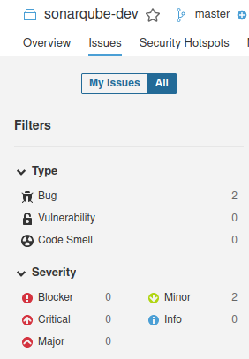
Testing

Slide 10




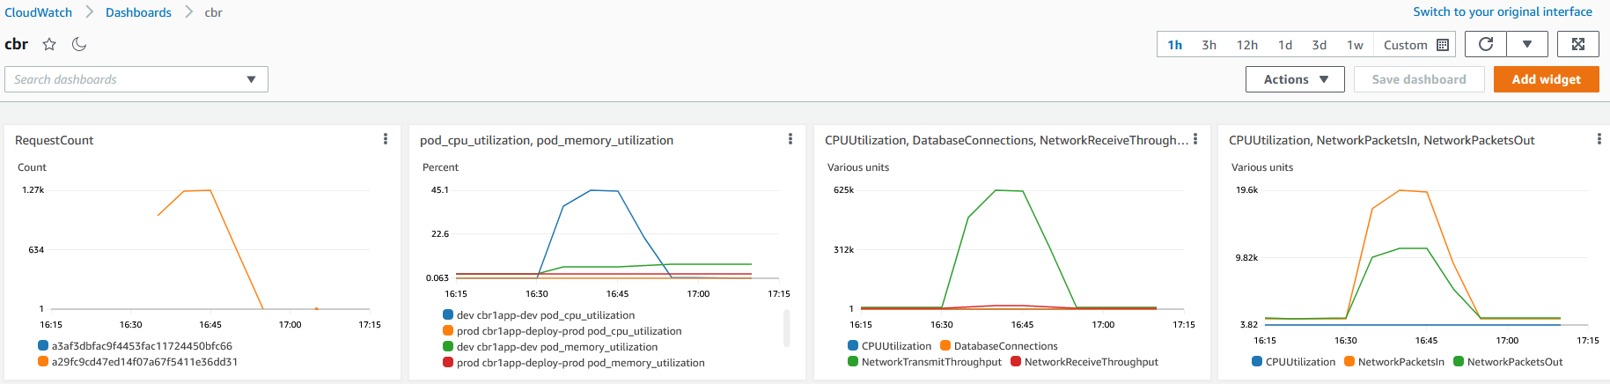
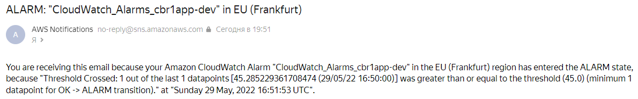
Monitoring

Slide 11
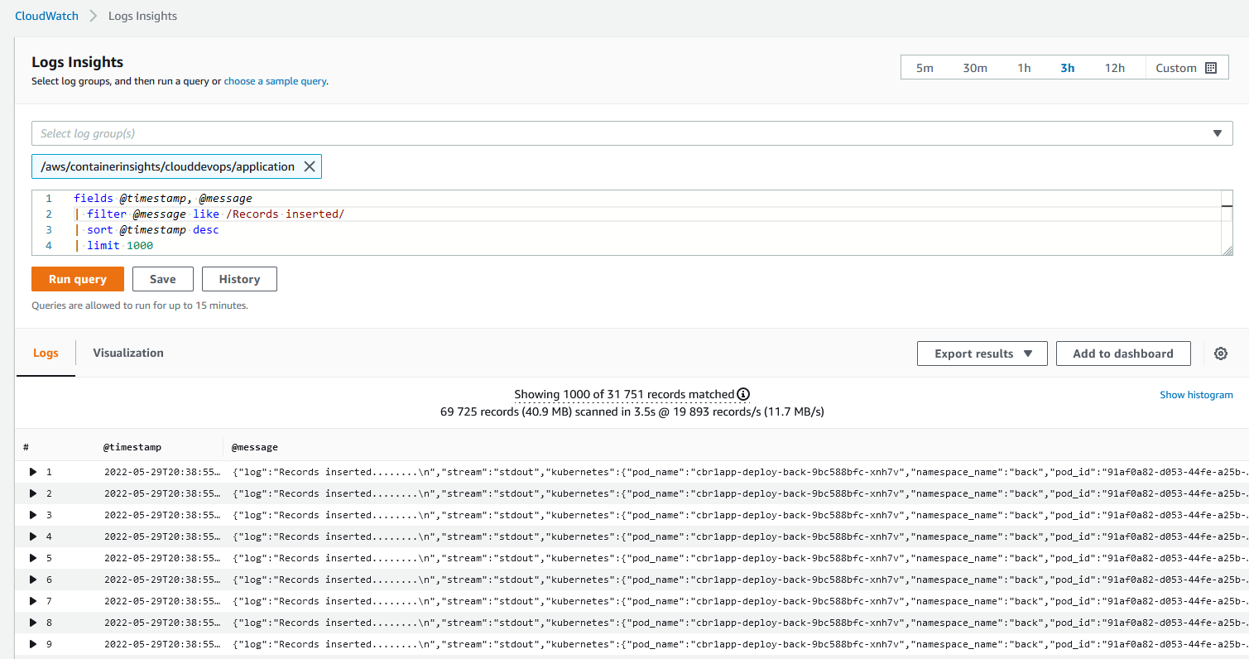
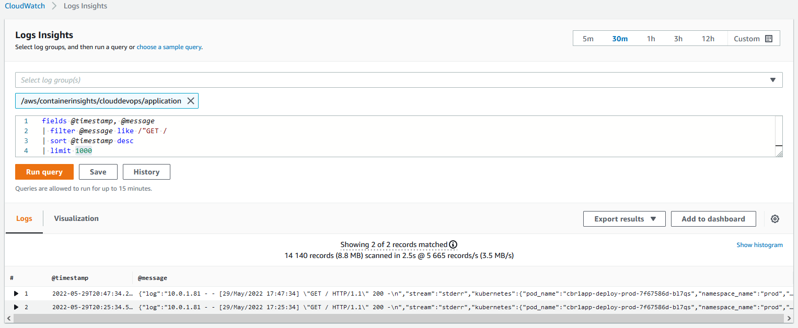
Logging

Slide 12
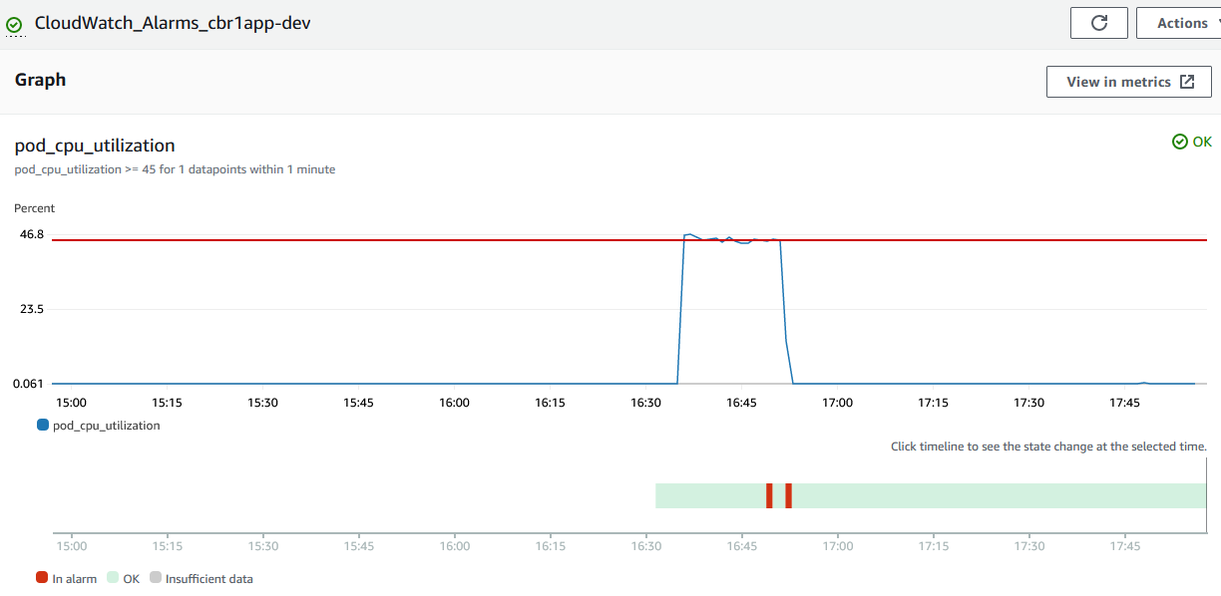
Scalability
based on K8S Horizontal pod autoscaler
LOAD
OFF
LOAD
ON

Slide 13
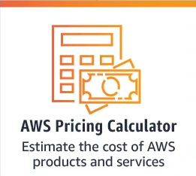
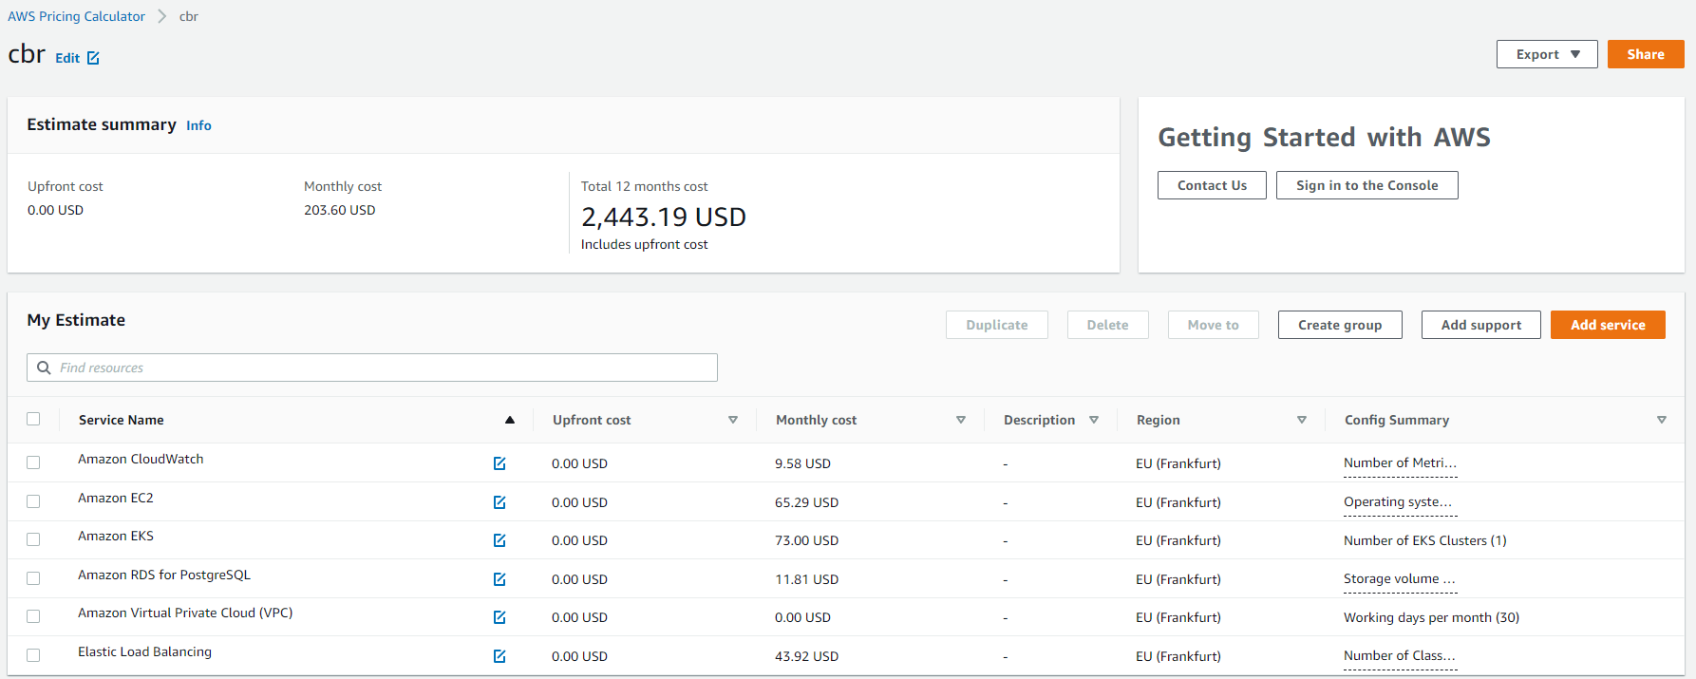
Cloud and Cost efficiency

Slide 14
Q&A
Student:
Ildar Sharafeev
2022

